Slide 1
Introduction to
Database Design
Chapter-2
BN ShankarGowda, BIT

Slide 2
Conceptual Database Design
ER-Modeling
BN ShankarGowda, BIT

Slide 3
Database Design Activities
Step 1: Requirement Gathering: | TEXTUAL description of Data
Sep 2: Requirement Analysis or Conceptual Database Design: | GRAPHICAL representation of Data
Step 3: Logical Database Design or ER-Relational mapping: | RELATIONAL Schema structures (Table structures)
BN ShankarGowda, BIT

Slide 4
Step 4: Schema Refinement or Normalization : This is done through normalization theories. | Refined Tables
Step 5: Implementation using query language. | Database
Step 6: Physical Database Design: Low level implementation like indexing and clustering of tables.
BN ShankarGowda, BIT

Slide 5

Data Models
Model of
system
in client’s
mind
Entity model of
client’s model
Table model
of entity model
Server
Tables on disk
B.N.ShankarGowda, BIT

Slide 6
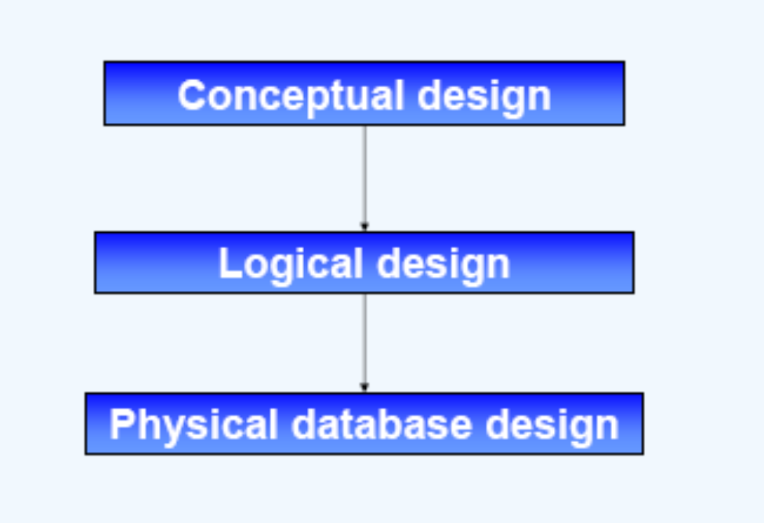
Design Levels of Database
BN ShankarGowda, BIT

Slide 7
Conceptual Design
Entity Relationship Modeling
BN ShankarGowda, BIT

Slide 8
Database Design Techniques
Top down Approach: Analysis
Top down starts by defining the data sets and then define the data
elements within those sets. As a result of this method, you generally
end up with redundant information in one or more tables.
Some references call this Entity - Relationship modeling.
Bottom Up approach: Synthesis
Bottom up starts by defining the required attributes and then grouping
them to form the entities.
Another term used for this method is Normalization from functional dependencies.

Slide 9
ER Modeling
-Top down Approach

Slide 10
ER modeling
ER modeling: A graphical technique for understanding and organizing the data independent of the actual database implementation.
Components of ER-Model
Entity: Any thing that may have an independent existence and about which we intend to collect data. also known as Entity type.
Relationship: Associations between entities.
  E.g.: Trainee belongs to a Batch
Attributes: Properties/characteristics that describe entities.
  E.g.: Trainee Name, BatchName, DOB, Address, etc.

Slide 11
Entity Types
Regular Entity:
Any Entity that has its own key attribute (s)/ Identifying attribute (s).
Identifying or Key attribute is one that can UNIQUELY identify each and every single instance or record of that relation.
E.g.: Employee, student ,customer, policy holder etc.
Weak entity:
An Entity that depends on other entity for its existence and doesn’t have key attribute (s) of its own.
E.g. : Dependent of employee
Notes:
The spouse data is identified with the help of the employee id to which it is related

Slide 12


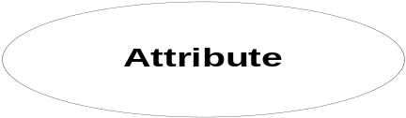
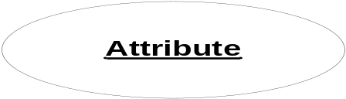
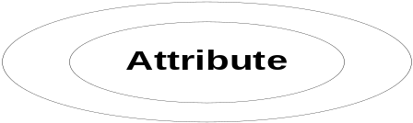
ER Modeling -Notations
 | An Entity is an object or concept about which business user wants to store information.
 | A weak Entity is dependent on another Entity to exist. Ex: Dep_Name depends upon EMPNO for its identification. Without EMPNO it is impossible to identify Dpe_Name uniquely.
 | Attributes are the properties or characteristics of an Entity.
 | A key attribute is the unique, distinguishing characteristic of the Entity
 | A multi-valued attribute can have more than one value. For example, an employee Entity can have multiple skill values.

Slide 13
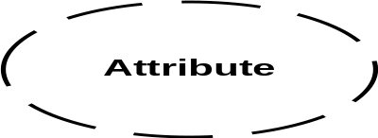

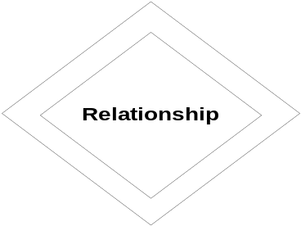
ER Modeling -Notations
 | A derived attribute is based on another attribute. For example, an employee's monthly salary is based on the employee's basic salary and House rent allowance.
 | Relationships illustrate how two entities share information in the database structure.
 | To connect a weak Entity with others, you should use a weak relationship notation.

Slide 14
E-R Model Chen in 1970
ER modeling :
A graphical technique for understanding and organizing the data, independent of the actual database implementation.
Graphical or pictorial representation of data.
Theoretical way of analysis.
Cannot be implemented.
Components of ER-Model
ENTITIES
ATTRIBUTES
RELATIONSHIPS
BN ShankarGowda, BIT

Slide 15
Entity
Entity:
An entity is anything in a real world with an independent existence based on which we gather data.
Eg. Car, Accounts Department , DBMS Book, etc.
BN ShankarGowda, BIT

Slide 16
Entity Types
Strong Entity:
An Entity that has a Key attribute of its own
  Eg: Emp (Emp_id, SSN) Student( Stud_id)
Weak Entity:
An Entity that does not have a key/ identifying attribute and which is DEPENDENT on other entity for its existence
BN ShankarGowda, BIT

Slide 17
Weak Entity
E#
Rel
Name
1
has
N
dependant
Employee
The DEPENDANT entity is represented by a double lined rectangle and the identifying relationship by a double lined diamond
Notes:
The identifying relationship is the one which relates the weak entity (dependant) with the strong entity (Employee) on which it depends.
Id is underlined with a dotted line because it is used to form composite key of dependent entity along with E#.

Slide 18
WEAK ENTITIES
Weak Entity
A weak entity set is an entity set such that its key is composed of attributes some or all are of which belong to another entity set.
Weak entity sets do not have their own key attributes (only partial key allowed).
A weak entity will always have total participation with the identifying owner entity.
The owner entity set and the weak entity set must participate in 1:M relationship.
BN ShankarGowda, BIT

Slide 19
Strong vs. Weak Entity
Strong entity set:
  – Has sufficient attributes to form a primary key
Weak entity set:
  – Lacks sufficient attributes to form a primary key
  – Hence, lacks sufficient attributes to form any key
But every entity set needs a key; What to do?
  – Must import attributes from strong entity set(s)
  – A weak entity set member is subordinate to the dominant entity from strong entity set providing attributes to complete its key
BN ShankarGowda, BIT

Slide 20
Weak Entity
DEPENDENT
Dep_ID | Dep_Name | Dep_Rel | Dep_DOB | Dep_Gender
dp_01 | Aa | wife | 01-jan-80 | F
dp_02 | Bb | Son | 01-jan-00 | M
dp_03 | Cc | daughter | 01-jan-02 | F
dp_04 | Dd | father | 01-jan-60 | M
dp_05 | Ee | mother | 01-jan-62 | F
What If an attribute like Dep_ID is present in the DEPENDENT table ? Can’t we call this a strong entity.
1. It is not possible to co-relate employee with Dependent.
2. It is not possible to maintain details of more than one dependent.
3. Every dependent has to have the same name
BN ShankarGowda, BIT

Slide 21
ER Diagram
Multi-Valued
Key Attribute
Weak Entity
Composite
Derived
Weak Relationship
BN ShankarGowda, BIT

Slide 22
ATTRIBUTES
Attributes are the ones that BEST characterize an Entity or
Attributes are Properties of an Entity or Attributes describe an entity.
Employee: Emp_ID, SSN, Name, DOB, Sal…etc
Types of Attributes
The attributes are classified into any of the following types based on the need. I.e., for one application an attribute may be simple and the same attribute may be composite for other application.
BN ShankarGowda, BIT

Slide 23

Attributes Types
Types of Attributes | Definition | Example
Simple attribute | Cannot be divided into simpler components | Gender of the employee
Composite attribute | Can be split into components | Address of the employee
Single valued | Can take on only a single value for each entity instance | Age of the employee
Multi-valued | Can take up many values | Skill set of the employee
Stored Attribute | Attribute that need to be stored permanently | Date of joining of the employee
Derived Attribute | Attribute that can be calculated based on other attributes. | Years of service of the employee

Slide 24
Simple/Atomic:
An attribute that can not be further sub-divided Eg: Gender, Regno,SSN
Composite attributes :
An attributes that can be sub-divided / decomposed into some more attributes or can be split into more components. Eg: Address, Regno,SSN
Single valued attributes :
An attributes that can hold only one value. Eg. Gender, DOB
Multivalued attributes :
An attributes that can take more than one value. Eg: Degrees
Stored attributes :
An attributes that is used for deriving a value for another attribute. Eg. DOB, Sal
Derived attributes :
can be derived from other attribute(s). Eg. Age, Annual sal
BN ShankarGowda, BIT

Slide 25
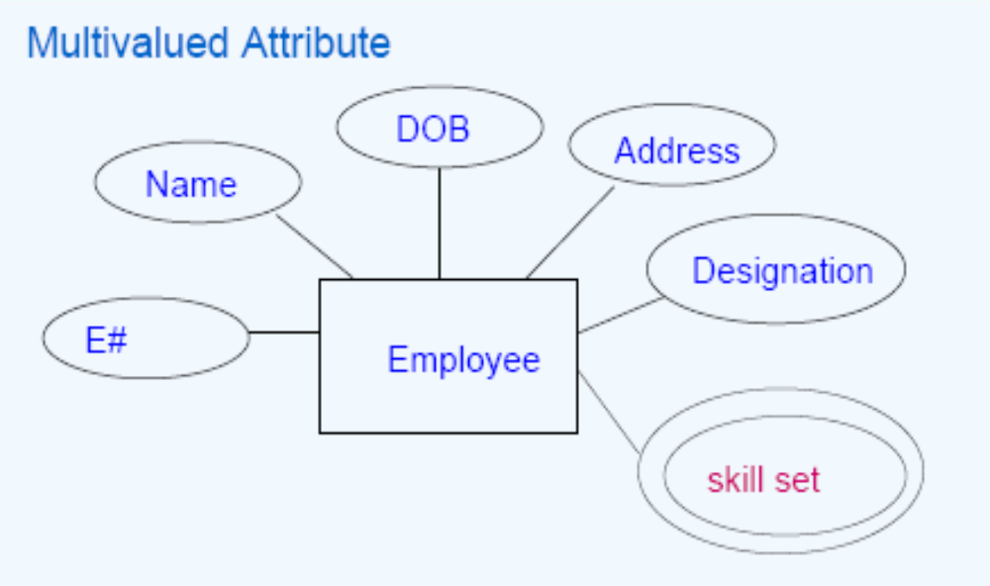
BN ShankarGowda, BIT

Slide 26
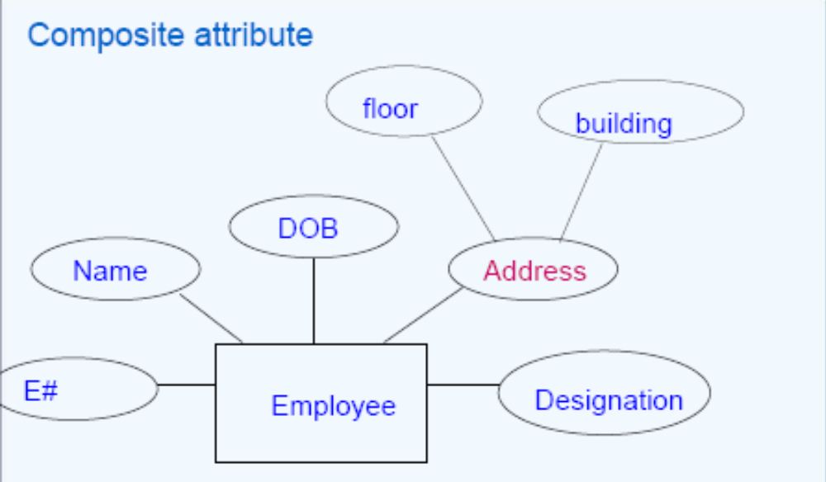
BN ShankarGowda, BIT

Slide 27
Relationships
Incase of relationship there is no concept of type of relationship
Three Aspects of Relationship
Degree of Relationship:
CARDINALITY/CONNECTEDNESS
Participation of Relationship.
BN ShankarGowda, BIT

Slide 28
A DOCTOR TREATS PATIENTS AND PRESCRIBES MEDICINE IN A HOSPITAL
A DOCTOR TREATS PATIENTS
A DOCTOR PRESCRIBES MEDICINE
BN ShankarGowda, BIT

Slide 29
Degree of a Relationship
Degree: the number of entity types involved in a relationship
    Unary Degree Relationship
    Binary Degree Relationship
    Ternary Degree/N-ary Relationship
E.g
An Employee manages many Employees is unary
Employee works-for Department is binary
Customer purchase Item from a Shop keeper is a ternary relationship
BN ShankarGowda, BIT

Slide 30
Unary Relationship set
The number of participating Entity is Only one
Manages
Manager
subordinate
Employee
A unary relationship is represented as a diamond which connects one entity to itself as a loop.
The relationship above means, some instances of employee manage other instances of Employee.
BN ShankarGowda, BIT

Slide 31
Binary Degree Relationship
Employee works_for a Department
Here the number of participating entities is two i,e Employee and Department
date
Works_For
Employees
Departments
BN ShankarGowda, BIT

Slide 32
Instance of Works_For
e₁
e₂
e₃
r₁
r₂
r₃
d₁
d₂
d₃
Employees Works_For Departments
BN ShankarGowda, BIT

Slide 33
Ternary Relationship Set
Supplier supply parts for projects
the number of participating entities are three
PName
SName
location
Sid
SAddr
PNo
Supply_for
Suppliers
Projects
PtNo
Parts
PtName
BN ShankarGowda, BIT

Slide 34
Instance of ternary Relationship Set
Supply_For
S₁
S₂
S₃
r₁
r₂
r₃
P₁
P₂
P₃
Pt₁
Pt₂
BN ShankarGowda, BIT

Slide 35
CARDINALITY
Constraints on Relationship Types
Cardinality Ratio: Cardinality specifies the connectedness that exists between the ENTITY INSTANCES/VALUES.
Relationships can have different connectivity
The minimum and maximum values of this connectivity is called the cardinality of the relationship
Types of cardinality mappings.
  ONE-TO-ONE (1:1)
  ONE-TO-MANY (1:N)/ MANY TO ONE (N:1)
  MANY-TO-MANY (M:N)
BN ShankarGowda, BIT

Slide 36
One-to-One cardinality (1:1)
An Employee MANAGES only one department and a department
IS MANAGED BY ONLY ONE EMPLOYEE.
MANAGES
Employee
Department
D10
D20
E1
E2
E3
E4
E5
Employee E2 managing department D10
Employee E3 managing department D20
BN ShankarGowda, BIT
Notes:
hgfhgfhg

Slide 37
1:1 Cardinality
One instance of Employee( One Employee say E1) is connected to only one instance of Department Entity D1.
One instance of Department entity can be connected to only one instance of Employee Entity.
This restriction can be shown with an arrow in the ER diagram from Departments entity set to Manages relationship and another arrow from Employees entity set to Manages.
BN ShankarGowda, BIT

Slide 38
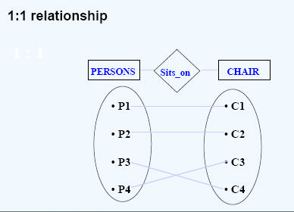
One instance of entity type PERSON is connected to exactly one other entity instance of entity type CHAIR
BN ShankarGowda, BIT

Slide 39
One-to-Many cardinality (1:M)
An Employee can WORK_FOR Only one Department AND A Department can have MANY Employees Working_for it.
Works_For
Employees
Departments
m
1
E1
E2
E3
E4
E5
D10
D20
One instance/record of Employee Entity is connected to exactly one instance/record Department Entity.
One instance/record of Department Entity is connected to more than one instance of Employee Entity.
BN ShankarGowda, BIT

Slide 40
BN ShankarGowda, BIT

Slide 41
One-to-Many cardinality (1:M)
An Employee can WORK_FOR Only one Department AND A Department can have MANY Employees Working_for it.
Works_For
Employees
Departments
m
1
E1
E2
E3
E4
E5
One instance/record of Employee Entity is connected to exactly one instance/record Department Entity.
One instance/record of Department Entity is connected to more than one instance of Employee Entity.
BN ShankarGowda, BIT

Slide 42
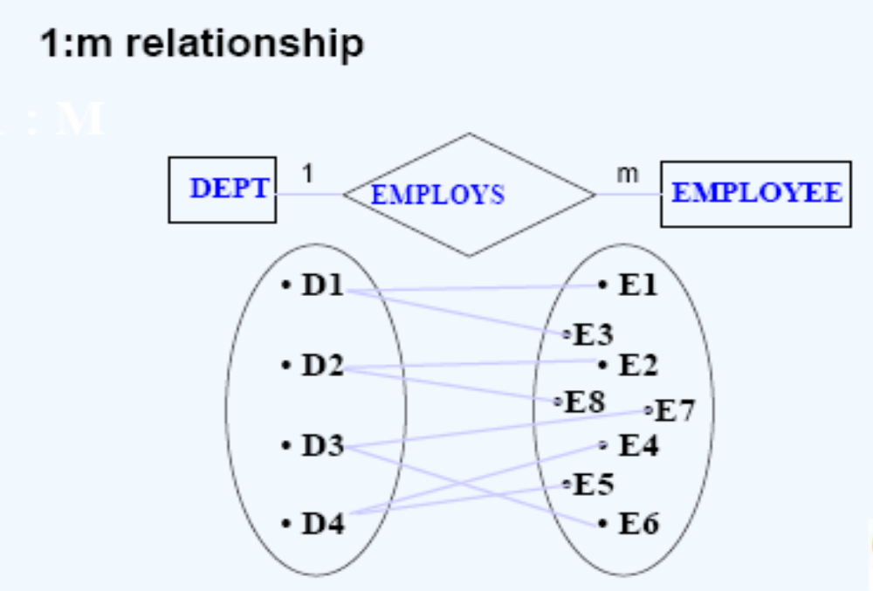
BN ShankarGowda, BIT

Slide 43
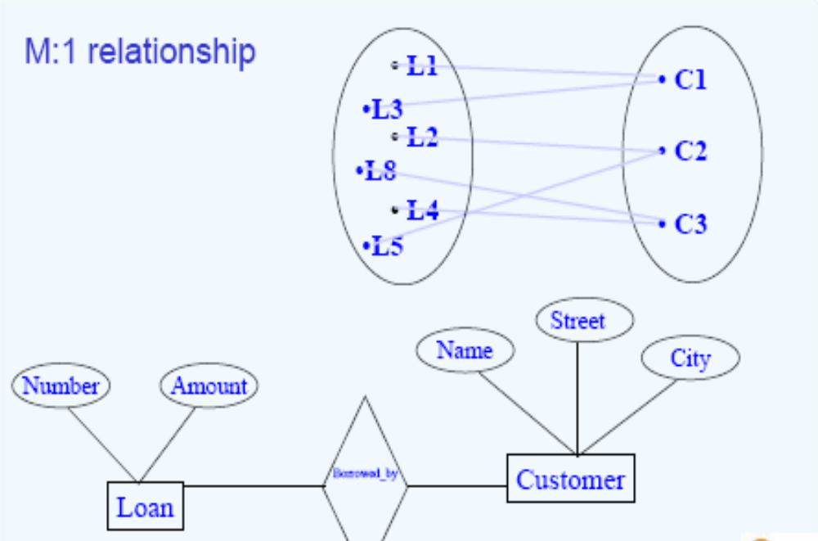
BN ShankarGowda, BIT

Slide 44

Many-to-Many Cardinality (M:N)
A STUDENT registers for many subjects and a COURSE can be registered by many students.
Registers for
M
N
COURSES
Register for
1BI18CS162
1BI18CS163
18CS51
18CS52
18CS53
18CS54
BN ShankarGowda, BIT
One instance of STUDENT Entity type is connected to MANY instances/records of SUBJECT Entity. AND
One instance of SUBJECT entity type is connected to MANY instances of STUDENT entity.

Slide 45
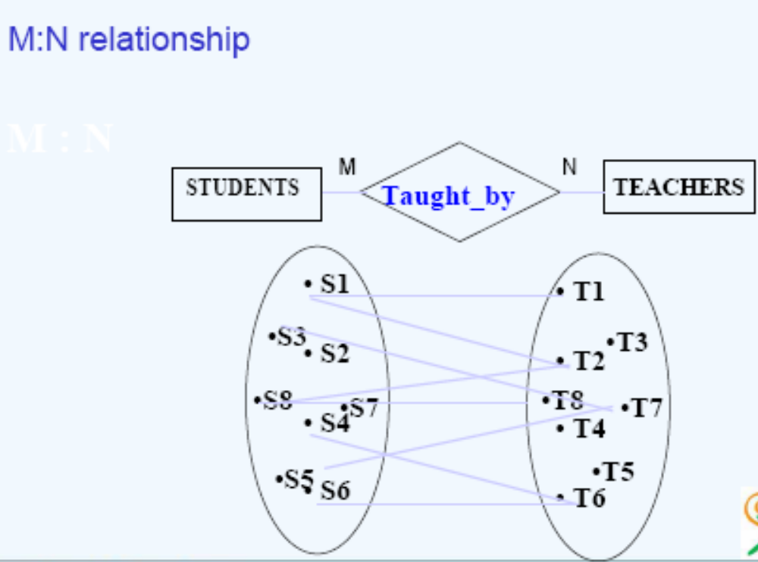
BN ShankarGowda, BIT

Slide 46
Relationship Participation
Total : Every ENTITY INSTANCE must be connected THROUGH THE RELATIONSHIP to another instance of the other participating entity types.
Partial: All instances of an ENTITY may not participate in forming the RELATIONSHIP.
Not all employees are managers, but all department should have a manager.
E.g Employee Head-of Department
Works_For
Employees
T
P
Departments
BN ShankarGowda, BIT

Slide 47
Total Participation:
assume that the company policy is that every department should have a manager. This implies that there will be a full or total participation between Departments and Manages. Therefore, this type of participation is called as total participation (represented as thick or double line).
BN ShankarGowda, BIT

Slide 48
Total Participation
Manages
Employees
Departments
Total Participation
since
The thick line (blue line) indicates total
participation.
BN ShankarGowda, BIT

Slide 49
Total Participation
E1
E2
E3
E4
E5
D1
D2
D3
EMP
WORKS_FOR
DEPT
BN ShankarGowda, BIT

Slide 50
Partial Participation
When an entity set E does not participate fully with a relationship and in turn to the participating entity, such a constraint is called as partial participation.
Manages
Employees
Departments
Partial Participation
since
BN ShankarGowda, BIT

Slide 51
Partial Participation
E1
E2
E3
E4
E5
D1
D2
D3
EMP
MANAGES
DEPT
BN ShankarGowda, BIT

Slide 52
Example
amount
Payment-date
Payment-no
loanno
Loan-payment
Employees
Payments
Payment-amount
BN ShankarGowda, BIT

Slide 53
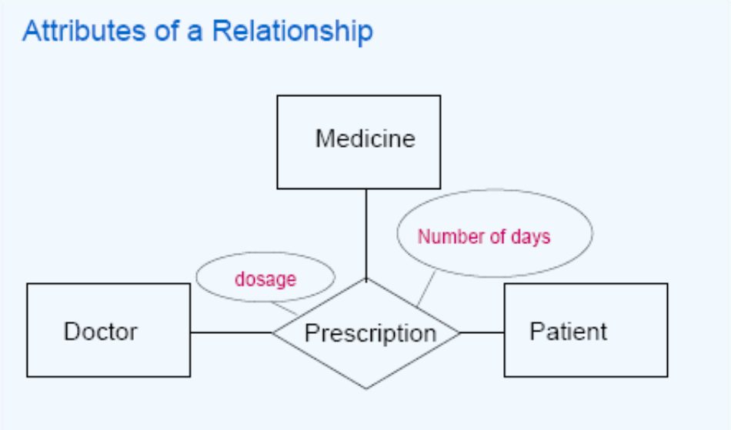
Attributes of Relationships / Descriptive Relationships
BN ShankarGowda, BIT

Slide 54
DATABASE ABSTRACTIONS
An abstraction of some system is a model of that system in which certain details are deliberately hidden.
In some applications a system may have too many details that need to be managed and provide abstraction. During such instances, it can be managed by decomposing the model into hierarchy of abstractions.
A relation in Codd's relational schema supports two types of abstractions – Generalization and Aggregation.
BN ShankarGowda, BIT

Slide 55
Extended ER features
Super types & Subtypes
Sometimes different entity types are actually specializations of a more general entity type
– Example: Rose, jasmine, lotus, lily are all flowers
Some attributes are common to all, others are specific to one entity type Represented by a generalization hierarchy
supertype :The attributes that are common belong to the supertype and
subtype :those that are specific belong to the particular subtype
subtypes may be disjoint or overlapping
BN ShankarGowda, BIT

Slide 56
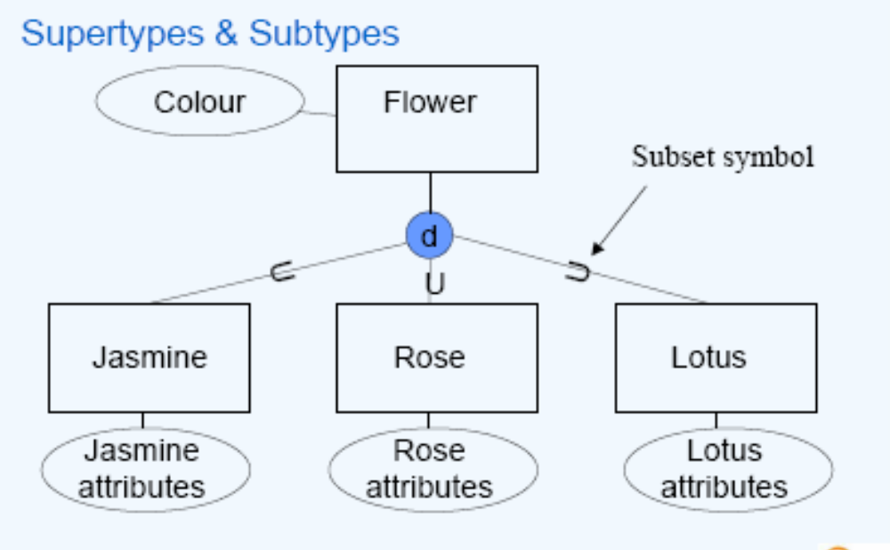
BN ShankarGowda, BIT

Slide 57
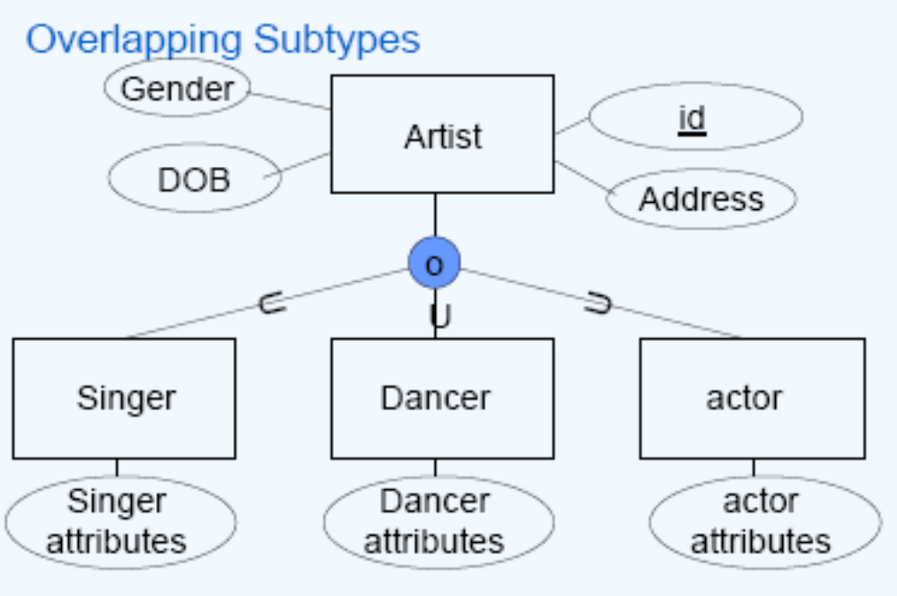
The diagram depicts a overlapping subtype relationship– e.g a person who’s a singer could also be a dancer.
BN ShankarGowda, BIT

Slide 58
GENERALIZATION
IS A
A generalization is an abstraction which enables a class of objects to be thought of generically as a single named object.
We can think of generalization as a relationship between an entity (or class) and one or more refined versions of it.
The generalization is represented through what is known as ISA relationship
BN ShankarGowda, BIT

Slide 59
Example - 1
AccNo
Balance
Account
ISA
SB
FD
RD
CA
Int_amt
Dep_amt
Rec_amt
Od
BN ShankarGowda, BIT

Slide 60
Example - 1
name
dob
gen
person
IS A
stud
fac
emp
cust
ENO
USN
FID
CID
IS A
BN ShankarGowda, BIT
salary
parttime
full

Slide 61
Example-2
Employee
(SSN, Name, Addr, Sex)
Fulltime_Employee
(Days_worked, Salary )
Contract_Employee
( Contract_period, Contract_amount )
BN ShankarGowda, BIT

Slide 62
AGGREGATION
Aggregation is an abstraction through which relationships are treated as higher-level entities.
The ER diagram lacks in establishing a relation between relationships sets. Using our knowledge of ER diagram, we can construct the relationship among the three entities Employees, Projects and Machines with Works_on and Uses relationships.
BN ShankarGowda, BIT

Slide 63
Example
Name
Hrs
PNo
PName
SSN
Addr
Works_on
Employees
Projects
Uses
To
From
Machines
Mid
OS
Type
OS
BN ShankarGowda, BIT

Slide 64
Why not use a ternary relationship?
Combine Works_On and Uses to a single relationship set? No! Because, each one has its own attribute(s).
Works_On has Hrs and
Uses has From and To (dates) attributes.
Hence, the solution is aggregation.
BN ShankarGowda, BIT

Slide 65
ER Diagram with Aggregation
Hrs
Works_On
Employees
Projects
Aggregation
Uses
To
From
Machines
BN ShankarGowda, BIT

Slide 66
Attributes of Relationships / Descriptive Relationships
BN ShankarGowda, BIT

Slide 67
ER Diagram with Aggregation
TREATS
DOCTOR
PATIENT
Aggregation
PRESCRIBES
To
From
MEDICINE
BN ShankarGowda, BIT

Slide 68
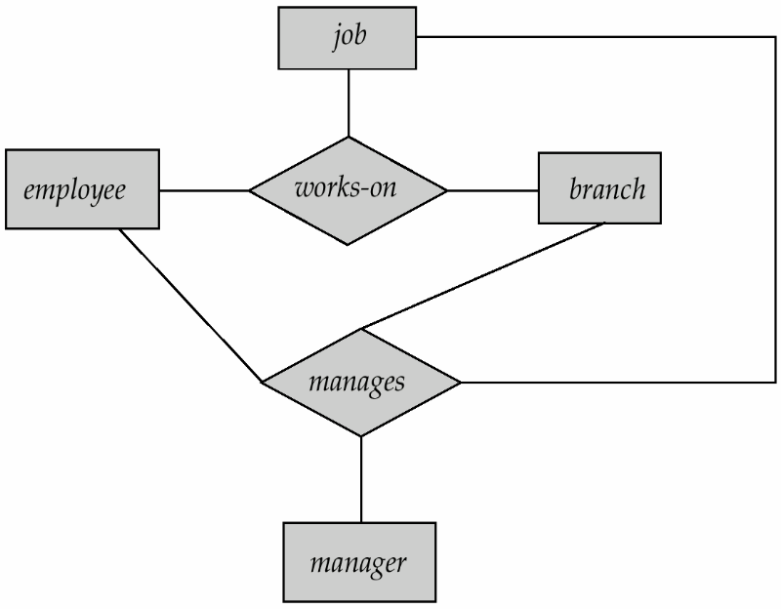
Example - 2
Suppose we want to record managers for tasks performed by an
employee at a branch
• Relationship sets works-on and
manages represent overlapping information
– Every manages relationship corresponds to a works-on relationship
– However, some works-on relationships may not correspond to any manages relationships
• So we can’t discard the works-on relationship
Eliminate this redundancy via aggregation
– Treat relationship as an abstract entity
– Allows relationships between relationships
– Abstraction of relationship into new entity
BN ShankarGowda, BIT

Slide 69
Example – 2 (contd…)
• Without introducing redundancy, the diagram shown in the right represents:
– An employee works on a particular job at a
particular branch
– An employee, branch, job combination may
have an associated manager
BN ShankarGowda, BIT

Slide 70
Merits and Demerits of ER Modeling
Merits
Easy to understand. Represented in Business Users Language. Can be understood by non-technical specialist.
Intuitive and helps in Physical Database creation.
Can help in database design.
Gives a higher level description of the system.
Demerits
Physical design derived from E-R Model may have some amount of redundancy which may lead to inconsistency.
(This will be discussed when we study Normalization on day two)
Sometime diagrams may lead to misinterpretations because of limited information present in the diagram.

Slide 71
        Case Studies
BN ShankarGowda, BIT

Slide 72
A RBI Banking Scenario
RBI has to maintain the details of various Banks. Banks are identified by a code, and has name, address of the main office.
Banks have branches. Branches are identified by a branch number, and has branch name and an address.
Branches maintains various Accounts and loans.
Account details maintained are Acc_Id, Acc_type (savings, current) and Acc_balance maintained w.r.t to Acc-types.
Loan details maintained are loan_Id, loan_ type (car, home, personal) and loan_amount offered w.r.t each loan_type.
Customers can hold one or more type of Account in one or more branch/es of one /more Banks.
Customers can Avail one/ more type of loans from one or more branch/es of one /more Banks..
Customers are identified by Cname, Custid, C_address.
BN ShankarGowda, BIT

Slide 73
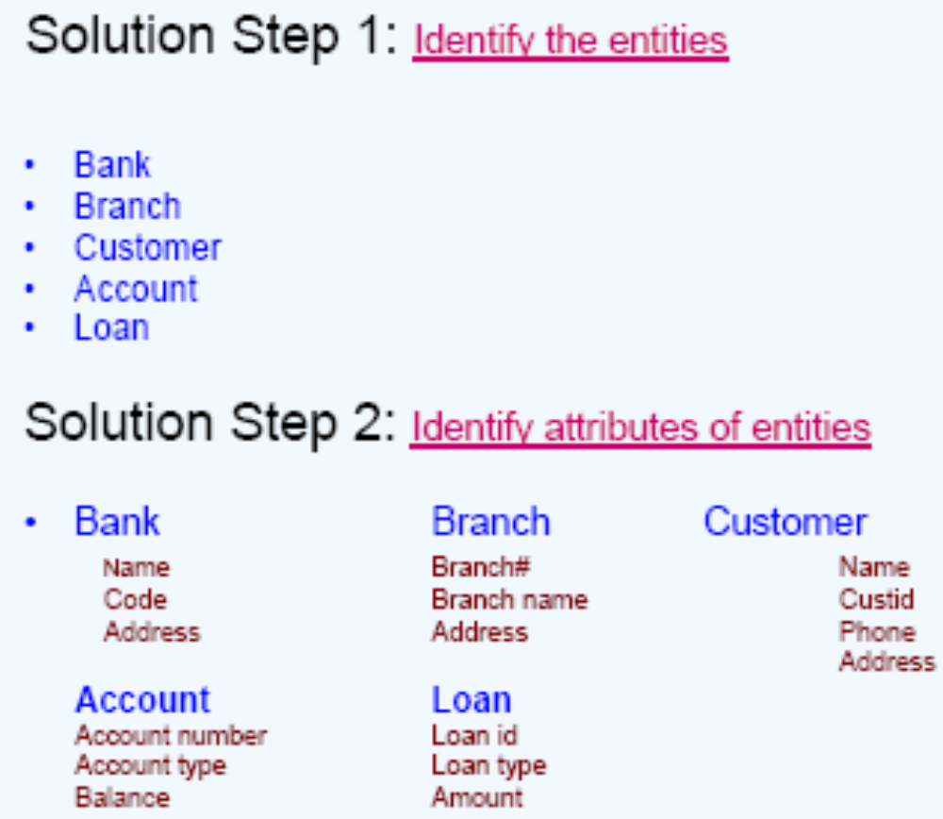
BN ShankarGowda, BIT

Slide 74
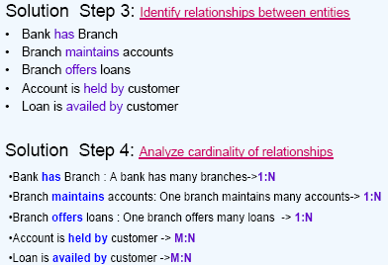
BN ShankarGowda, BIT

Slide 75
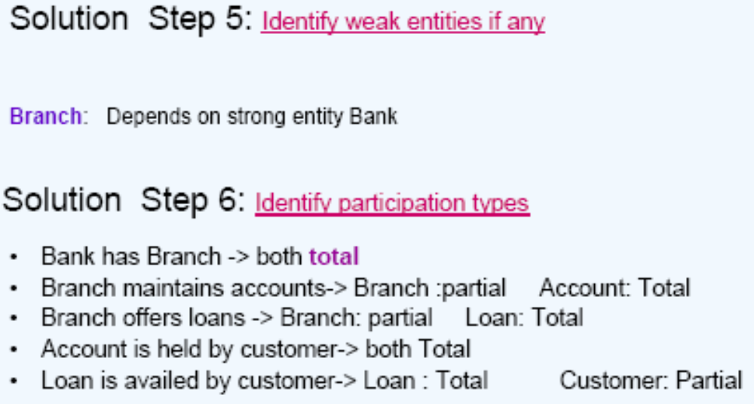
BN ShankarGowda, BIT

Slide 76
Weak Entity
Branch
Just by having branch code it is not possible to specify branch of which Bank. Hence, we must associate Bank_code with Branch Table .
Branch
Branch_code | Branch_name | Address
04 | Basavanagudi
71 | Jaynagar
72 | Indiranagar
Bank_code | Branch_code | Branch_name | Address
CB | 04 | Basavanagudi
HSBC | 71 | Jaynagar
CB | 71 | Jaynagar
HSBC | 04 | Basavanagudi
BN ShankarGowda, BIT

Slide 77
Account Entity
RBI wants to keep track of the ACCOUNT BALANCE in SB Account of all branches of CB.
RBI wants to keep track of the ACCOUNT BALANCE in Current Account of Jaynagar branch of CB.
ACCOUNT
ACC_ID | A_TYPE | A_BAL
A1 | SB | 1000 Lacs
A2 | CA | 100 Lacs
A3 | RD | 2000 Lacs
A4 | FD | 300 Lacs
BN ShankarGowda, BIT

Slide 78
Loan Entity
RBI wants to keep track of the LOAN AMOUNT of Vehicle Loan of all branches of CB.
RBI wants to keep track of the LOAN AMOUNT of Vehicle Loan of Jaynagar branch of CB.
LOAN
L_ID | L_TYPE | L_AMT
L1 | VL | 1 Lac
L2 | JL | 1Lac
L3 | HL | 2 Lac
L4 | ML | 3Lac
BN ShankarGowda, BIT

Slide 79
Weak Entities
Bank_code | Branch_code | ACC_ID | A_TYPE | A_BAL
CB | 04 | A1 | SB | 1000 Lacs
HSBC | 71 | A2 | CA | 100 Lacs
CB | 71 | A2 | CA | 2000 Lacs
HSBC | 04 | A1 | SB | 300 Lacs
ACCOUNT
Bank_code | Branch_code | L_ID | L_TYPE | L_AMT
CB | 04 | L1 | VL | 1 Lac
HSBC | 71 | L2 | VL | 1Lac
CB | 71 | L2 | HL | 2 Lac
HSBC | 04 | L1 | HL | 3Lac
LOAN
BN ShankarGowda, BIT

Slide 80
RBI BANKING APPLICATION
BN ShankarGowda, BIT

Slide 81
A college contains many departments.
A department keep track of Dnumber, Dname, and a Location
Each department offers many courses and a Course is offered by one department.
With respect to each Course, we got to keep track of Cnumber, Cname.
Many instructors works in a department and An instructor works for one department .
An instructor can be head of only one department and a department has a Head.
Each instructor can take any number of courses and A course is taught by one instructor
For each Instructor Inst_ID, I_Name, I_Ph, I_Addr is recorded.
A student enrolls for many number of courses and Each course has many number of students.With respect to each student, USN, S_Name, S_Ph, Email are stored

Slide 82
Step 3: Find the relationships
One course is enrolled by multiple students and one student enrolls for multiple courses, hence the cardinality between course and student is Many to Many.
M N
The department offers many courses and each course belongs to only one department, hence the cardinality between department and course is One to Many.
1 M
One department has multiple instructors and one instructor belongs to one and only one department , hence the cardinality between department and instructor is one to Many.
1 M
ENROLLED BY
COURSE
STUDENT
OFFERS
DEPARTMENT
COURSE
HAS
DEPARTMENT
INSTRUCTOR

Slide 83
Step 3: Find the relationships(Cont..)
Each department there is a “Head of department” and one instructor is “Head of department “,hence the cardinality is one to one .
1 1
One course is taught by only one instructor, but the instructor teaches many courses, hence the cardinality between course and instructor is many to one.
M 1
DEPARTMENT
HEADED BY
INSTRUCTOR
OFFERS
COURSE
INSTRUCTOR

Slide 84
Step 3: Identify the key attributes
Dept_name is the key attribute for the Entity “Department”, as it identifies the Department uniquely.
Course# (Course_Id) is the key attribute for “Course” Entity.
Student# (Student Number) is the key attribute for “Student” Entity.
Instructor Name is the key attribute for “Instructor” Entity.
Step 4: Identify other relevant attributes
For the department entity, the relevant attribute is location
For course entity, course name, duration, prerequisite
For instructor entity, room#, telephone#
For student entity, student name, date of birth

Slide 85

Steps in ER Modeling

Slide 86
Draw an ER diagram of Online Retail Application which allows customer to purchase items from a Retail shop.
A customer can register to purchase an item. The customer will provide bank account number and bank name ( the customer may have multiple A/c no ).
After registration each customer will have unique cust_Id, user id, password.
Customer can purchases one or more item in different quantities . The items can be of different classes based on their price.
Based on the quantity , price of item and discount (if any) on the purchased items, the bill will be generated. Bank account number is required to settle the bill.
The application also mentions the information of suppliers who supply the items to the retail shop. The retail shop may give order to supply the items based on some statistics they maintain about different items.

Slide 87
Step 1: Identify the Entities
CUSTOMER
ITEM
SUPPLIER
BILL

Slide 88
Step 2: Find the relationships
Customer can purchase an item and each purchase will be corresponding to a bill. So it is a ternary relation ship.
Items can be ordered to one or more suppliers. One supplier may take order of many items. So many to many relationship between item and supplier.
One customer can pay many bill and one bill can be paid by only one customer. So one to many relation ship between customer and bill.

Slide 89
Step 3: Identify other relevant attributes of Entities & Relationships
For Customer entity the relevant attributes will be
(CustomerId,CustomerName, DateOfRegistration, UserId, Password, AccountNo)
For Item entity the relevant attributes will be
(ItemId, ItemName, UnitOfMeasurement, UnitPrice, Discount, QuantityOnHand, SupplierId,ReOrderLevel,ReOrderQuantity,Class)
For Supplier entity the relevant attributes will be
(SupplierID, SupplierName, SupplierContactNo)
For Bill entity the relevant attributes will be
( BillId, AccountNo, BillAmount, BillDate)

Slide 90
Step 3: Identify other relevant attributes of entities
For Purchase Relation the relevant attributes will be
(Qty_Purchased, Net_Price)
For OrderedTo relation the relevant attributes will be
(Oty_of_Order, Order_Date, Delivery_Date, Delivery_Status)
For Pays relation the relevant attributes will be (Account_No)

Slide 91
Step 4: Identify the key attributes
  Customer entity will be identified by CustomerId
  Item entity will be identified by ItemId
  Supplier entity will be identified by SupplierId
  Bill entity will be identified by BillId

Slide 92

Step 5:

Slide 93
Insurance Database
BN ShankarGowda, BIT

Slide 94
Insurance database
A Driver holding driver’s license can own one or more cars and he/ she is identified by Driver_ID, Dr_name, Dr_addr, Dr_DOB.
A particular car can be owned by only one Driver at any given point of time, but there could be more than one owner ( Ist owner, II nd owner, III rd owner…..) for that car over a period of time. Each car is identified by Reg_num,model, year_mfg.
The Driver driving a Car may participate in more than one Accident with the same car or with a different car on the same day or different days.
For each Accident the Report_number, Date_of_accident, and Location of accident are maintained.
The database has to keep track of the DAMAGE_AMOUNT claimed by Driver with respect to each Accident that involves his/her’s car.
BN ShankarGowda, BIT

Slide 95
COMPANY DATABASE
BN ShankarGowda, BIT

Slide 96
The COMPANY database
Each department has a unique name, a unique number and a particular department may be present in multiple locations. A department has many employees working for it and an employee work for only one department.
An employee manages a department and a department is managed by an employee. The start date when that employee began managing the department must also be recorded.
A department controls one or more number of projects, and a project is controlled by only one department.
Each project has a unique name, a unique number, and a single location.
An Employee has a empno, name, UID; address, salary, sex, and birth date.
An employee works on several projects, and a project has many employees working for it. The number of hours per week that an employee works on each project must be recorded.
An employee supervises many employees (subordinates) and an employee is supervised by only one employee.
For insurance purposes the company must keep track of dependent details like Dependents_name, sex, DOB, and relationship with the employee. An employee may have many dependents and a dependent belongs to only one employee.

Slide 97
ER Diagram
Step 1 : Identify Entities
  EMPLOYEES
  DEPARTMENTS
  DEPENDENTS and
  PROJECTS
Step 2: Identify Attributes of Entities
  EMPLOYEE: EmpNO, UID, EName, address, salary, sex, DOB
  DEPARTMENT: DNO, Dname, Locations
  DEPENDENTS: Dep_name, sex, DOB, relationship
  PROJECT: PNO, Pname, Loc
BN ShankarGowda, BIT

Slide 98
ER Diagram
Step 3: Identify Relationships
  Department has Employees or Employee works for Dept.
  Employee manages Dept. or Dept. managed by Employee
  Dept. controls Projects or Project controlled by Dept.
  Employee works on Projects or Project has Employees
  Employee has Dependents or Dependent belongs to Employee
  Employee supervises Employees
works
EMPLOYEE
DEPT
Supervises
EMPLOYEE
BN ShankarGowda, BIT

Slide 99
ER Diagram
Step 4: Identify Type of Entity
Strong / Regular
  EMPLOYEE: EmpNo,SSN,EName,address, salary, sex,DOB
  DEPARTMENT: DNO, Dname, Locations
  PROJECT: PNO, Pname, Loc
WEAK Entity
  DEPENDENTS: Dep_name, sex, DOB, relationship
BN ShankarGowda, BIT

Slide 100
Step 5: Identify Cardinality of Relationships
  A Department has MANY Employees
  1 M
  and AN Employee works for A Department.
HAS
DEPARTMENT
EMPLOYEES
BN ShankarGowda, BIT

Slide 101
Step 5: Identify Cardinality of Relationships
  A Department has MANY Employees and AN Employee works for A Dept.
  AN Employee manages A Department and A Dept is managed by AN Employee
  A Department controls MANY Project and A Project is controlled by A Dept.
  AN Employee works on MANY Project and A Project has MANY Employees working for it.
  AN Employee has MANY Dependents and A Dependent belongs to AN Employee
  AN Employee supervises MANY Employees and AN Employee is supervised by AN Employee.
BN ShankarGowda, BIT

Slide 102
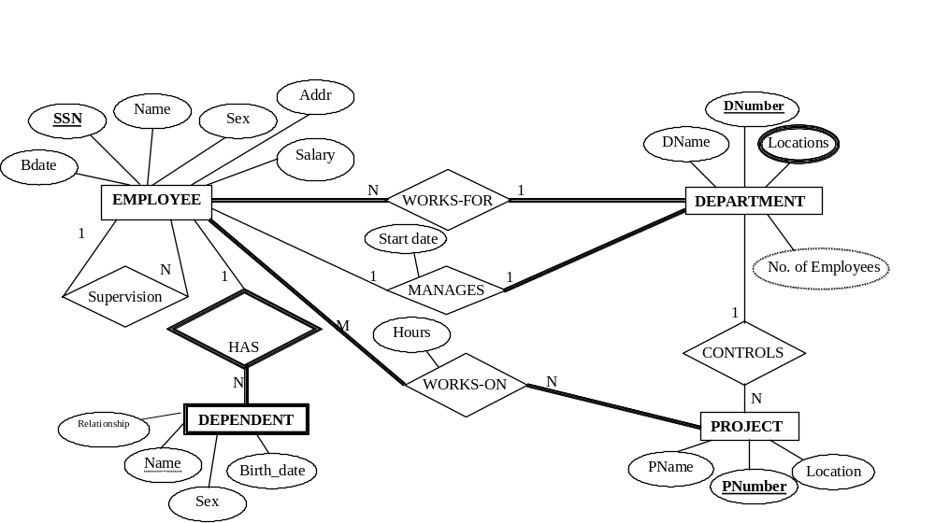
BN ShankarGowda, BIT
S. Nandagoapalan, BIT

Slide 103
Schemas of Company Database
EMPLOYEE: (EmpNO, UID, EName, addr, sal, sex, DOB , DNO)
DEPARTMENT: (DNO, Dname)
DEPT_LOCATIONS : (DNO, Location)
PROJECT: PNO, Pname, Loc, DNO
WORKS_ON: EmpNO, PNO, No_of_hours
DEPENDENTS: EMPNO, Dep_name, sex, DOB, relationship
BN ShankarGowda, BIT

Slide 104
Library System
Title
ISBN
Author
AquisNo
DatePur
Price
Publ
Book
Has
Copy
1
M
Date
M
1
Name
Borrows
Being
Custid
BirthDate
Customer
1
Requests
M
Reservation
ResNo
ResDate
Priority
Student
Faculty
Branch
Dept
Desig
Fee
Salary
BN ShankarGowda, BIT

Slide 105
College Database
Student
RegNo
StdName
Department
DNo
DName
Employee
SSN
Name
Phone
WorksFor
Attends
Heads
Section
SecNo
SecName
Budget
Professor
SSN
PName
Course
CourseId
CourseTitle
Credits
Teaches
Supervises
BN ShankarGowda, BIT

Slide 106
End of Chapter -2
⇨
BN ShankarGowda, BIT

